Slide 1
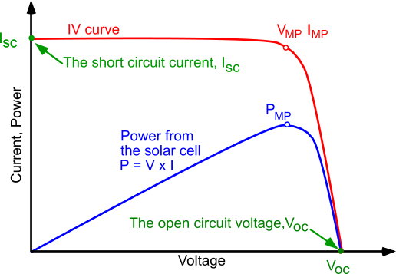
I V CHARACTERISTICS OF SOLAR CELL

Slide 2
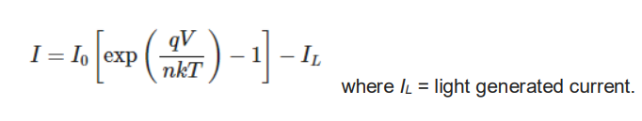
I V CHARACTERISTICS OF SOLAR CELL
The power produced by the PV cell in Watts can be easily calculated along the I-V curve by the equation P=IV.
At the I_{SC} and V_{OC} points, the power will be zero and the maximum value for power will occur between the two.
The voltage and current at this maximum power point are denoted as VMP and IMP respectively.

Slide 3
I V CHARACTERISTICS OF SOLAR CELL
Short Circuit Current (I_{SC})
Short circuit condition when the impedance is low and is calculated when the voltage equals 0. I (at V=0) = I_{SC}
Open Circuit Voltage (V_{OC})
Occurs when there is no current passing through the cell. V (at I=0) = V_{OC}
Maximum Power (P_{MAX}), Current at P_{MAX} (I_{MP}), Voltage at P_{MAX} (V_{MP})
The power produced by the PV cell in Watts can be easily calculated along the I-V curve by the equation P=IV.
At the I_{SC} and V_{OC} points, the power will be zero and the maximum value for power will occur between the two. The voltage and current at this maximum power point are denoted as V_{MP} and I_{MP} respectively.

Slide 4
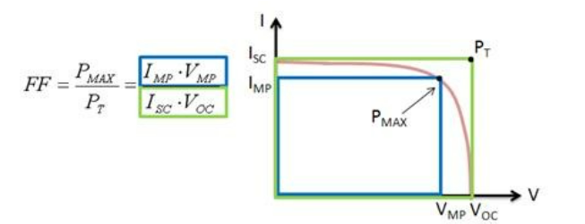
FILL FACTOR

Slide 5
FILL FACTOR
The Fill Factor (FF) is essentially a measure of the quality of the PV cell.
It is calculated by comparing the maximum power to the theoretical power (P_{T}) that would be output at both the open circuit voltage and short circuit current together
A larger fill factor is desirable and corresponds to an I-V curve that is more square-like.
Typical fill factors range from 0.5 to 0.82.
Fill factor is also often represented as a percentage.

Slide 6

Efficiency (η)
Efficiency is the ratio of the electrical power output Pout, compared to the solar power input, Pin, into the PV cell.
Pout can be taken to be P_{MAX} since the PV cell can be operated up to its maximum power output to get the maximum efficiency.
Pin is taken as the product of the irradiance of the incident light.

